Slide 1
Archetypes
Have I seen you somewhere before?

Slide 2
Make a list of a few heroes and heroines from some movies or a books you know.

Slide 3
Go ahead. I’ll wait.

Slide 4
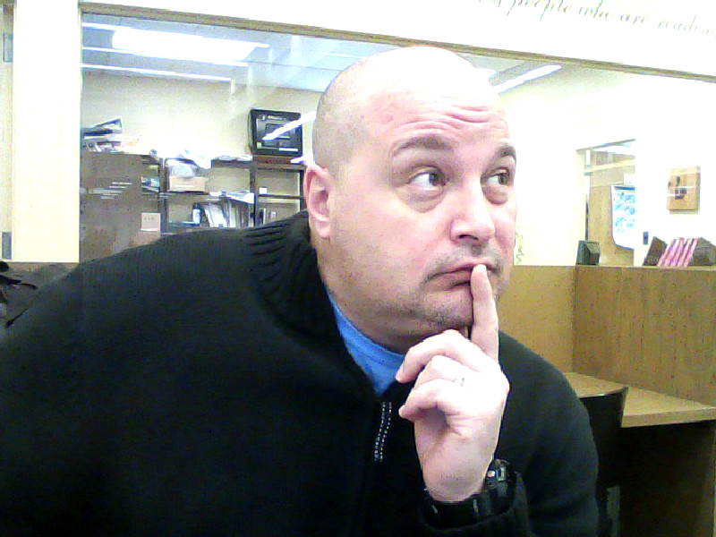
. . .?

Slide 5
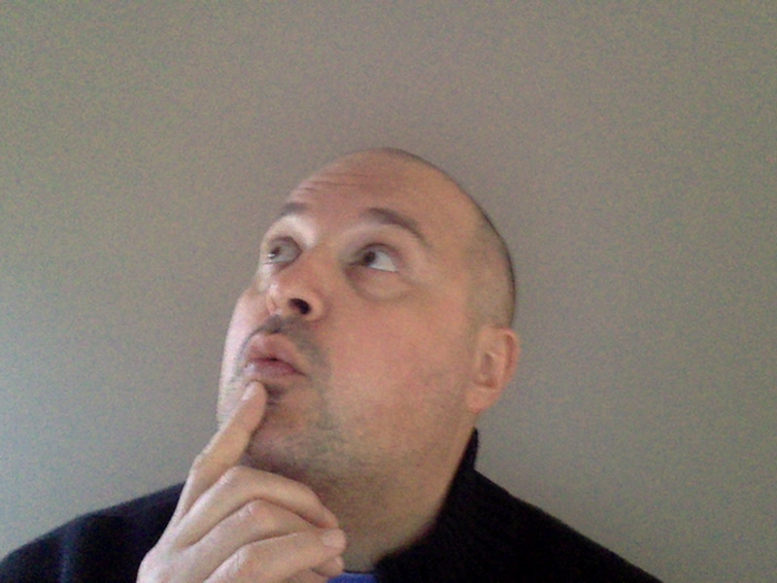
The Doctor from Dr. Who, Rey from Star Wars: The Force Awakens.
and Sherlock Holmes!
Or how about Thor, Elsa, Anna and Mulan?

Slide 6
Now that you have a few heroes / heroines in mind, think about what characteristics they all share.

Slide 7
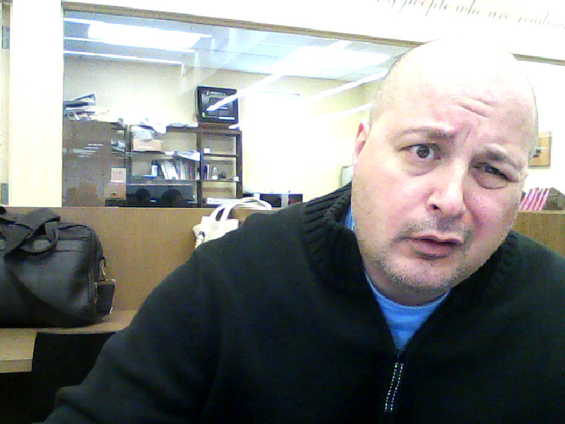
So ...What characteristics do all heroes share?

Slide 8
Courage in the face of adversity
Loyalty to their friends / loved ones
Willingness to do the right thing, even when it’s difficult
The ability to inspire others

Slide 9
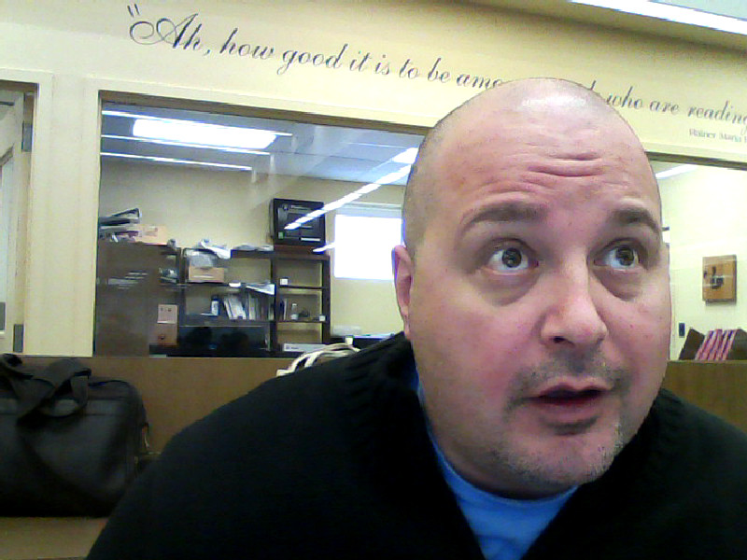
Gee ...I feel so inspired now!

Slide 10
Have you ever wondered WHY heroes and heroines have these features in common?

Slide 11
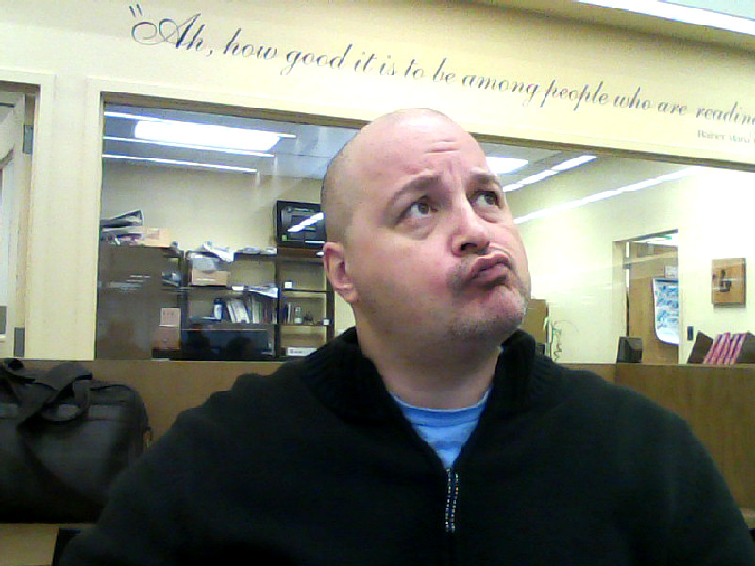
Now that you mention it...

Slide 12
There are a lot of reasons, actually, but one important reason is that they all fit the pattern of the Hero Archetype.

Slide 13
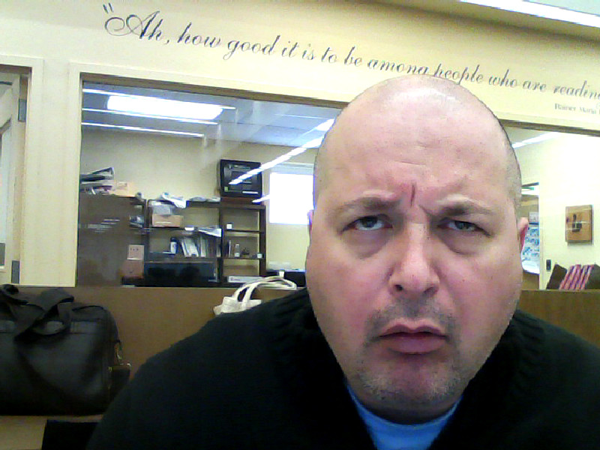
Archi-what-now?

Slide 14
An archetype is a pattern of ideas or images that is so basic, that people can understand it quickly and almost automatically.

Slide 15
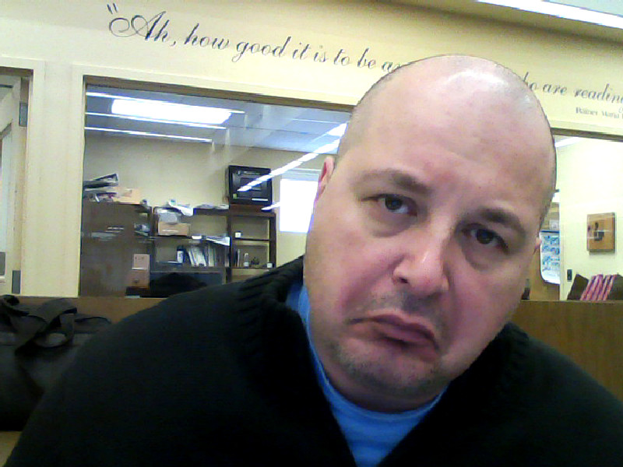
So?

Slide 16
So by understanding archetypes, you can understand all of the characters in movies and books.

Slide 17
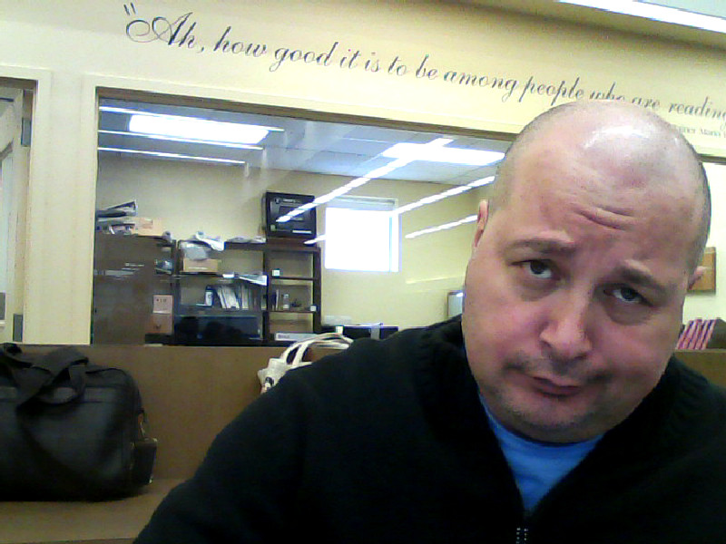
Seriously?

Slide 18
Absolutely! Let’s go back to the hero archetype for a moment. According to the the hero / heroine archetype, the hero or heroine in a story usually struggles against evil or oppression and saves people, right?

Slide 19
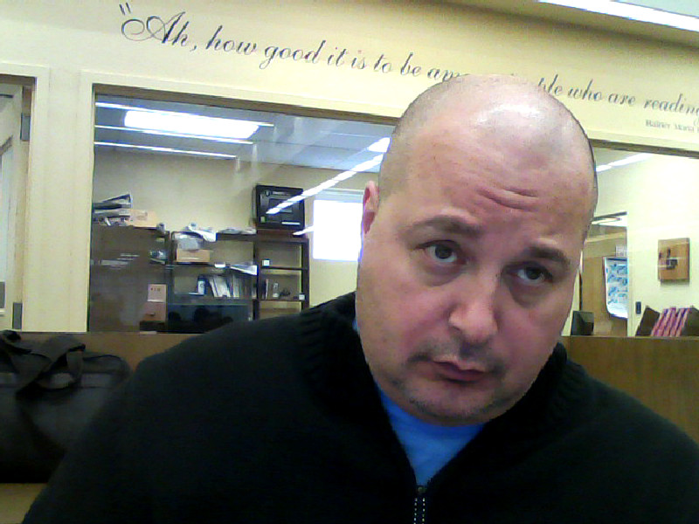
Okay ...

Slide 20
All heroes and heroines follow that pattern one way or another. Katniss struggles against the oppressive Capitol to bring justice to Panem

Slide 21
Batman struggles against evil supervillains to bring justice to Gotham City.

Slide 22
Mulan struggles against the Huns (and gender discrimination) to bring peace and harmony to China.

Slide 23
Dorothy kills the Wicked Witches of the East and West to bring peace to Munchkinland and Oz.

Slide 24
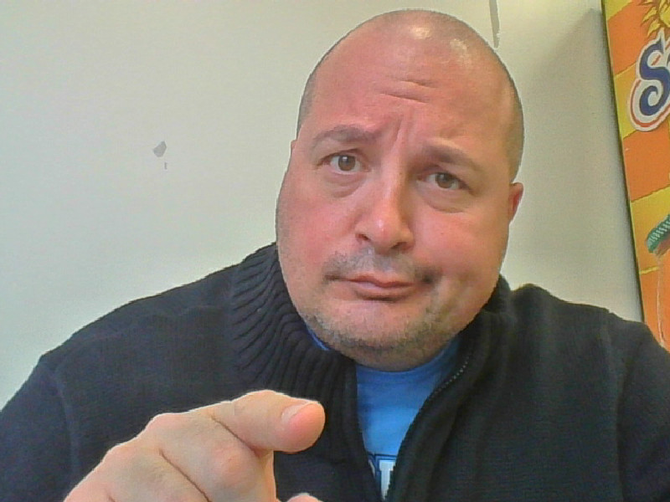
Now hold up! She killed BOTH witches by accident. Does that still make her a hero?

Slide 25
She shows courage, loyalty, determination… that’s pretty heroic. And the reason she kills the witches accidentally is because in addition to being a hero archetype, she’s also connected to the archetype of the innocent child.

Slide 26
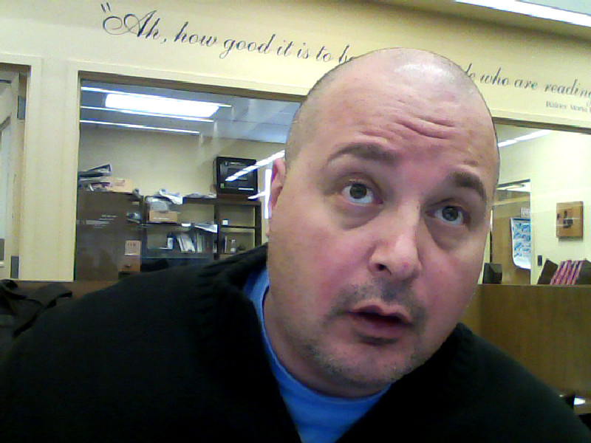
You can do that?

Slide 27
Most great characters in movies and books are a combination of archetypes.

Slide 28
So what other archetypes are there?

Slide 29
There are lots of archetypes. Too many to list them all here in fact!

Slide 30
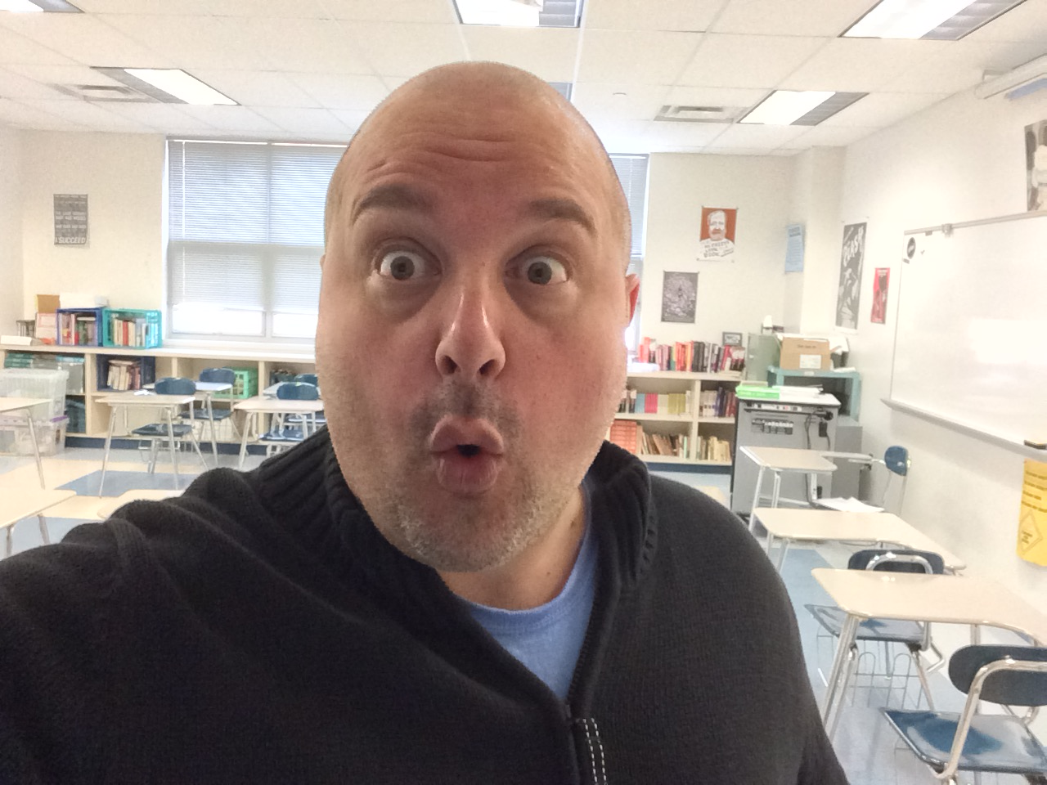
No way!

Slide 31
Way!

Slide 32
But to get a sense of what archetypes are and of how they work in literature, we can look at a few of the most common ones and then think about how those same characters appear in other stories in different forms.

Slide 33
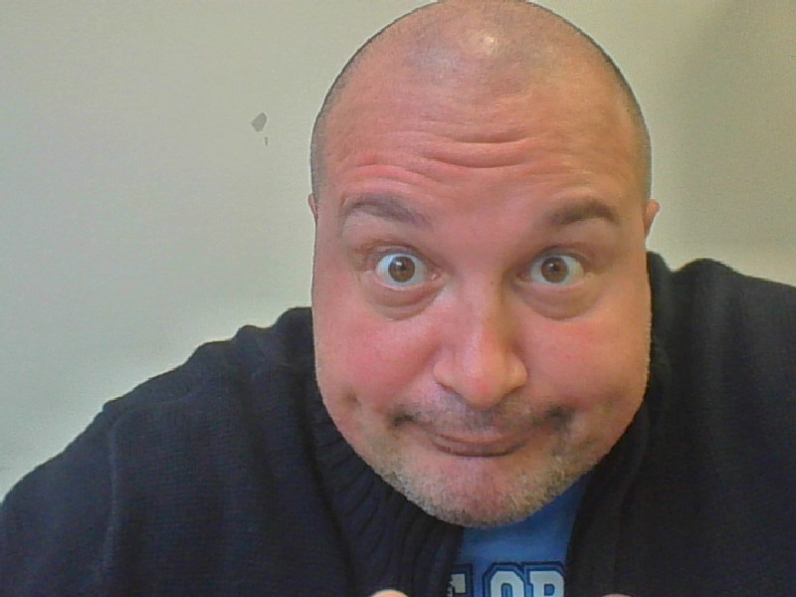
Okay. Let’s start with some classics.

Slide 34
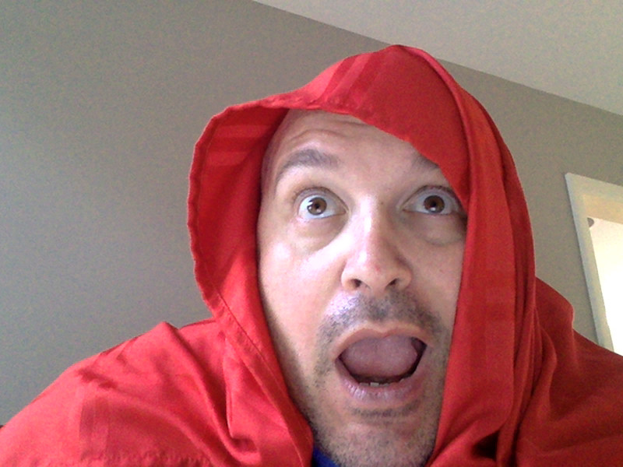
Like Little Red Riding Hood!

Slide 35
Sure. Snow White and Cinderella are also part of that archetype.

Slide 36
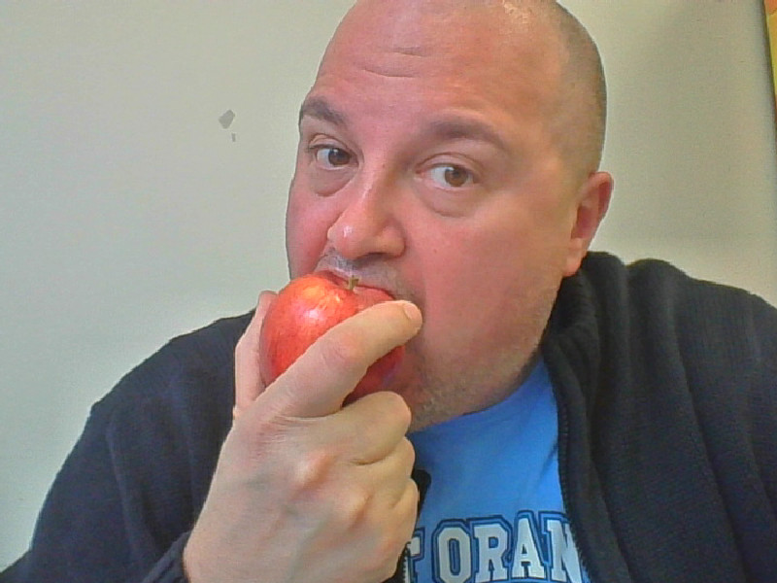
Check out my Snow White Impression.

Slide 37
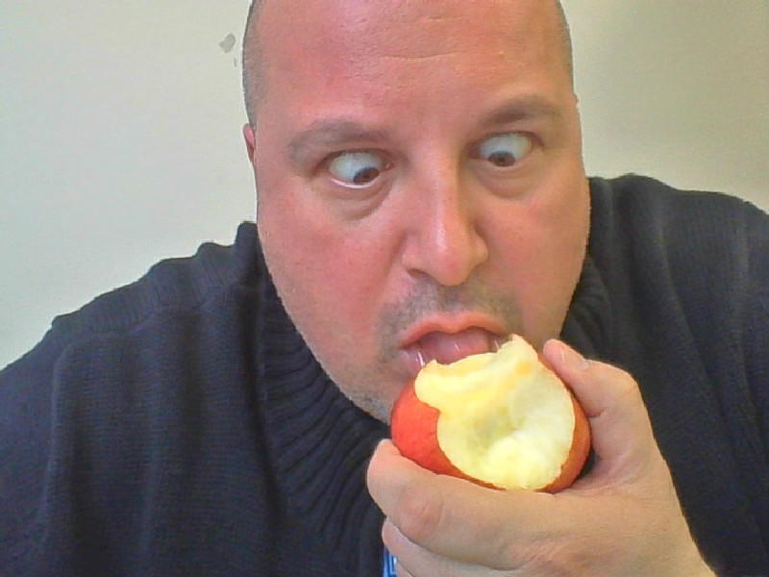
Oh no! Poison Apple!

Slide 38
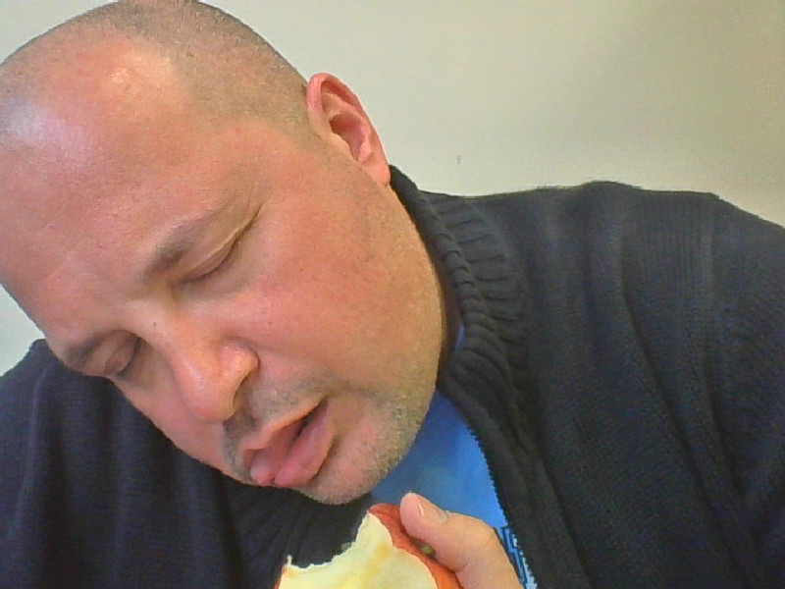

Slide 39
Don’t quit your day job.

Slide 40
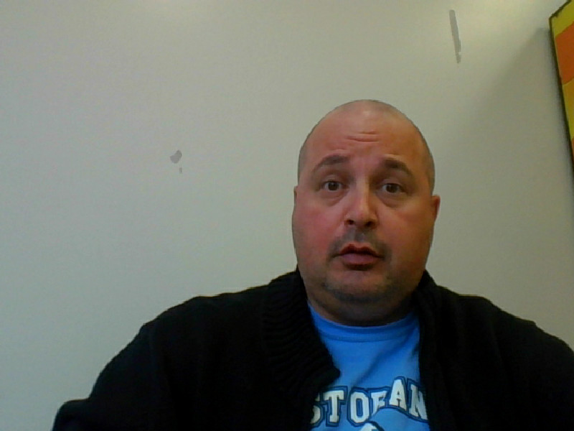
This is my day job! I have a Master’s Degree!

Slide 41
Anyhoo… Snow White, Red Riding Hood, Alice (Alice in Wonderland) are innocent (inexperienced and a little naive). Clever opponents can manipulate them because these innocent figures have not learned enough to know who to trust. In each case, learning this lesson is part of the story.

Slide 42
If you think about it, heroic characters like Bilbo Baggins, Katniss Everdeen and Rey (Star Wars) are also innocent archetype figures.

Slide 43
Other common archetypes are the mentor and the trickster.

Slide 44
What are those?

Slide 45
Let’s start with the mentor. A mentor is a person who helps the hero. Usually the mentor is older or at least more experienced, and gives the hero information and / or items to help the hero succeed.

Slide 46
Good examples of the classic mentor archetype are Obi Wan Kenobi, Gandalf and Dumbledore.

Slide 47
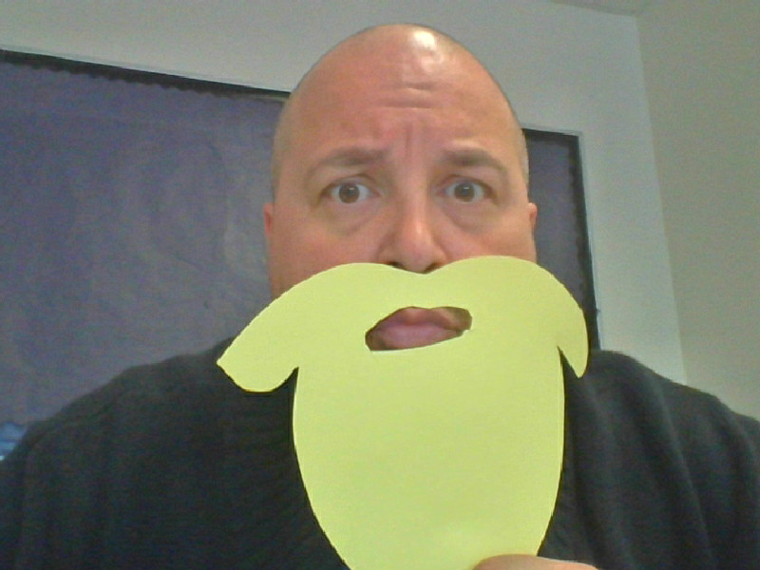
So a mentor is an old guy with a beard?

Slide 48
That’s true a lot of the time, but a mentor does not have to have a beard. It doesn’t even have to be a man. Yoda, Crush (the sea turtle in Finding Nemo), Glinda The Good Witch of the North, the fairy godmothers from many fairy tales are all connected to the mentor archetype.

Slide 49
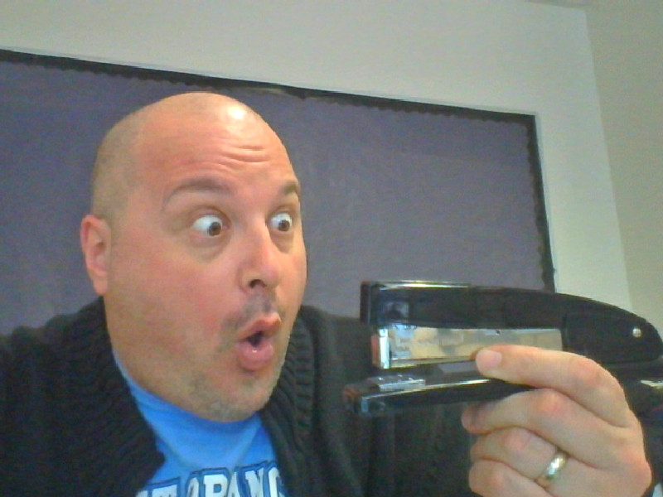
HEY check this out! I just met this new teacher by the copy machine. He gave me this MAGIC STAPLER and all I had to do was trade him all my lesson plans.

Slide 50
Magic stapler? It sounds like you might have met up with the trickster archetype.

Slide 51
The trickster is full of tricks and mischief. Some tricksters are basically good (or morally neutral) and they just like to cause trouble for fun or they need to use tricks to defend themselves.

Slide 52
Bart Simpson, Bugs Bunny, Jack Sparrow, Odysseus. All these characters use tricks and disguises to outwit stronger opponents.

Slide 53
There are evil tricksters also, who use their power to harm others.

Slide 54
The most famous examples of evil tricksters are The Joker, the Riddler and Loki. Buddy / Syndrome from the Incredibles is another trickster as is Tolkien's famous character, Gollum.

Slide 55
Another type of trickster is the shapeshifter. A character who transforms quickly, either physically or in their personality, into someone else.

Slide 56
The Wolf-Man, Mystique (X-Men), The Incredible Hulk are all examples of the shape-shifter archetype.

Slide 57
And the most powerful trickster archetype of all is Satan himself who, in many stories, uses tricks and changes his appearance to acquire souls.

Slide 58
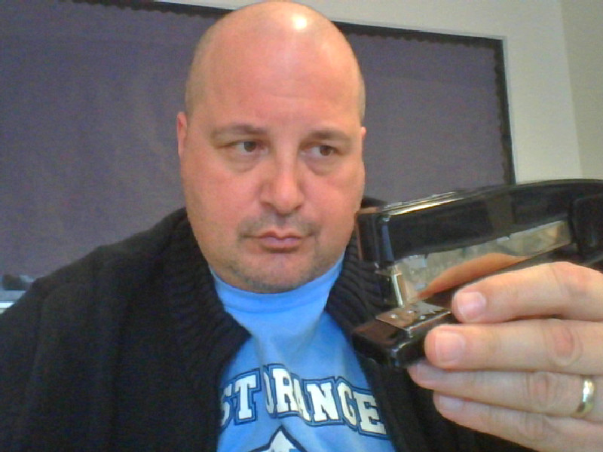
So this is just a piece of junk?

Slide 59
Not necessarily. Sometimes mentors act like tricksters as a way to test the hero. A classic example of this is when Luke Skywalker first meets Yoda. Luke is looking for a great Jedi master, but Yoda’s appearance is deceiving. Yoda lets Luke believe he is just an annoying swamp creature to see how his prospective student will handle the situation and Luke fails the test because of his prejudices. Luke learns his first lesson from Yoda.

Slide 60
When you write a story, consider using archetypes as you think about your characters and plots. Do a web search for archetypes and explore all these possibilities. Here are three to get you started. Incidentally, THREE is an archetype. Genies grant 3 wishes, Three bears, Three Musketeers, The Holy Trinity… even the Three Stooges.
Archetypes as Literary Devices
Common Archetypes
12 Common Archetypes

Slide 61
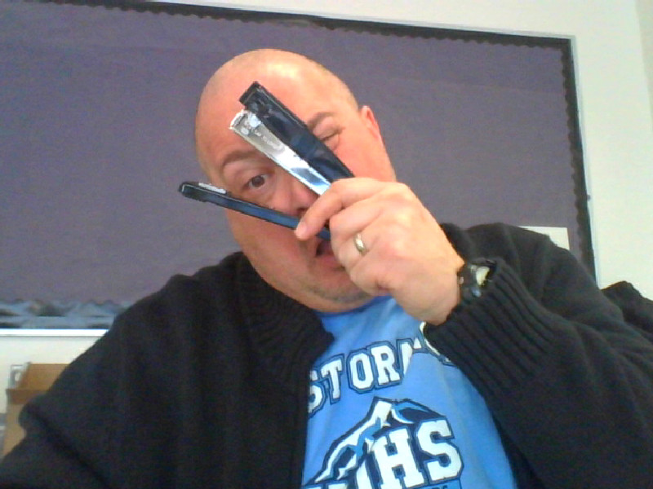
Happy Writing!
The magical stapler grabbed my nose!

